Slide 1

CMPP 257
Introduction to JavaScript & JQuery
Module 1: JavaScript Basics
Dr. Hamdy Ibrahim
CMPP 257: Introduction to JavaScript & JQuery

Slide 2



Ice Breaking
Hamdy Ibrahim: PhD in Software Engineering
Room: Senator Burns Building - NN409B
Email: hamdy.ibrahim@sait.ca
Name
Career/Job
Programming?
Expectation?
CMPP 257: Introduction to JavaScript & JQuery

Slide 3


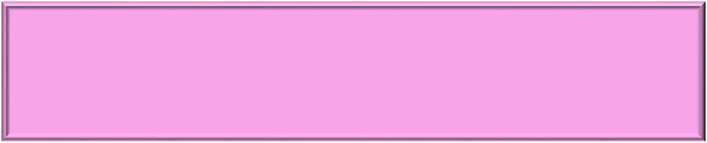
Class Plan
Time: Half & Half
Half: Theory
Half: Practicing
Break: @ 7:15 – 15mins
Ask when you need
Help & Support is not limited to the class
Out of the class work
CMPP 257: Introduction to JavaScript & JQuery

Slide 4
Outlines
Overview of the CMPP 257.
Evaluation Process.
JavaScript Overview
  <script>
  Comments
  User Interaction (alert, write, confirm, & prompt)
  Variables
  Operators
CMPP 257: Introduction to JavaScript & JQuery

Slide 5

CMPN 257 Overview
Course Material: 7 Classes
6 Classes
1 Class
In Last Class
JavaScript
JQuery
Final Exam
Concepts
Overview
Statements & Syntax
CMPP 257: Introduction to JavaScript & JQuery

Slide 6



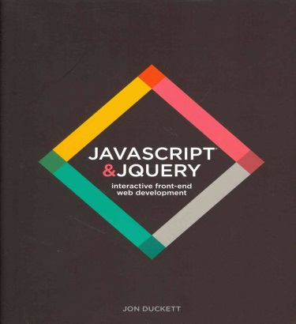

CMPN 257 Overview
Text Book
Evaluation
Any HTML & CSS Book
In-Class Exercises | 40%
Professionalism | 20%
Exams & Quiz | 40%
10% ➔ Quiz
Final ➔ 30%
CMPP 257: Introduction to JavaScript & JQuery

Slide 7


JavaScript Overview
Programming/Scripting Language
Client-Side Scripting Language
JavaScript
Developed by Netscape in May 1995
Enhancing Functionality and Adding Dynamics
Foundation for Server-Side Scripting
Programming Languages: Used to write programs
Communication with Computer
Statements & Strict Rules (Syntax) → must be followed
Syntax Violation → Errors
Fill the gap between human & Computer
CMPP 257: Introduction to JavaScript & JQuery

Slide 8


What is a Program?
Set of Instructions Written by Language
Performing a Specific Task/ Solving a Problem
Program/Script
Computer can Follow
Software Application: Set of Programs
Programmer: Writing/Implementing Programs
Follow Software Development Process
Program Structure
Statements: Syntax & Semantic
Practicing: Solving Many Problems
Code Reuse
How to Learn Programming Language?
CMPP 257: Introduction to JavaScript & JQuery

Slide 9


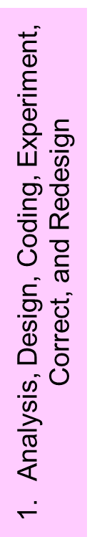
Programming Facts
Programming
Arts of Things Going Wrong
Programs Rarely Work the 1st Time they are Developed
Try & See → Time
Never Give Up → Time
Syntax vs. Logical Errors
CMPP 257: Introduction to JavaScript & JQuery

Slide 10

Programming Facts
Program Development: Iterative Process
1. Define the Goal → What do you want to achieve?
2. Design the Script → Identify # of tasks?
3. Coding each Step → Using JavaScript
4. Testing → Program Validity
Developed Programs must be Analytically Correct
SW Development >>> Writing Programs
CMPP 257: Introduction to JavaScript & JQuery

Slide 11

JavaScript Overview
JavaScript
Lightweight Programming Language
Less Memory Space
Client-Side Processing
Minimalist Syntax and Features
Browser Reads and Runs the Code
Easy to Use
No Communication with a Server
Fast & Immediate Response
Completely Different Languages
Java is more Powerful & Complex
JavaScript & Java
CMPP 257: Introduction to JavaScript & JQuery

Slide 12


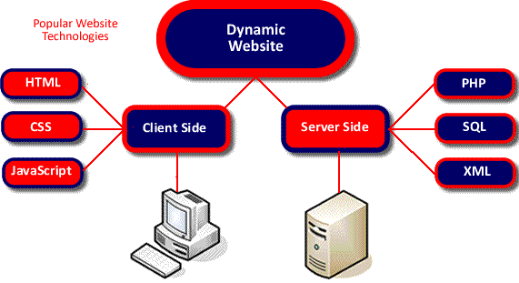
JavaScript Overview
JavaScript
JavaScript: Interpreted
Client-Side Scripting
Program
Input
Interpreter
Output
Client/Server Computing Model
Interpreter = Browser
CMPP 257: Introduction to JavaScript & JQuery

Slide 13


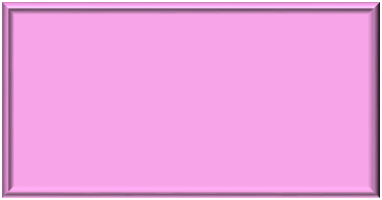


Website: Progressive Enhancement
1
2
3
.html
.css
.js
Content
Styles, Formatting, Presentation
Behavior, Interactivity, or Dynamics
+
Structure
CMPP 257: Introduction to JavaScript & JQuery

Slide 14

What can JavaScript Do?
JavaScript
Dynamically Adding/Changing Page’s Text
Shopping Carts
Special Graphics and Text Effects
Reacting to Events (e.g. Button Click)
Clocks
Read/Write HTML Elements
Image Swapping and Slide Show
Form Validation
Much More
Calculations
CMPP 257: Introduction to JavaScript & JQuery

Slide 15


Writing a Script: Tools
Tools
Plain Text as HTML and CSS→ Text Editor
Browser = Interpreter
<!DOCTYPE html>
<html>
<head>
<title>
</title>
</head>
<body>
</body>
</html>
Preparing HTML Template
CMPP 257: Introduction to JavaScript & JQuery

Slide 16

Including JavaScript in HTML
<script> Within <HEAD>
<script type=“text/javascript”>
JS statement 1 or code;
JS statement 2 or code;
</script>
    Functions and code that may execute multiple times is typically placed in the <HEAD>
CMPP 257: Introduction to JavaScript & JQuery

Slide 17

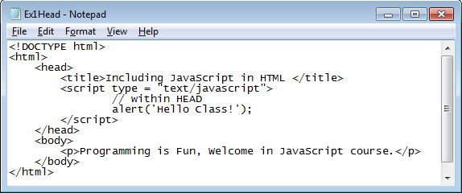
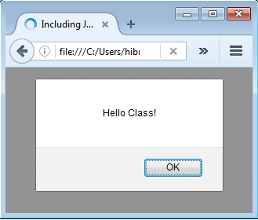
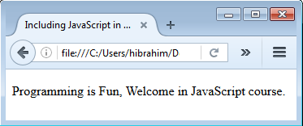
Including JavaScript in HTML
<script> Within <HEAD>
Comment
“message”
alert() displays an alert box with a specified message and an OK button.
CMPP 257: Introduction to JavaScript & JQuery

Slide 18


Including JavaScript in HTML
<script> Within <BODY>
<script type=“text/javascript”>
JS statement 1 or code;
JS statement 2 or code;
</script>
    Code that needs to be executed only once, when the document is first loaded is placed in the <BODY>
Change the code in Slide 20 to include <script> within <BODY> before & after <p>
Try it
    Is there any difference? When will the script run?
CMPP 257: Introduction to JavaScript & JQuery

Slide 19

Including JavaScript in HTML
Script within HTML Document
Visible in the Client Browser
Solution 1: Use External File
      <script type = "text/javascript"
      src = "file.js"></script>
      Solution 2: Use Server Scripting → More Secured
CMPP 257: Introduction to JavaScript & JQuery

Slide 20
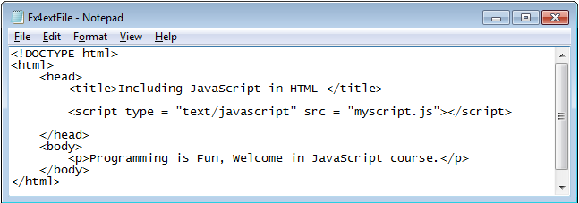
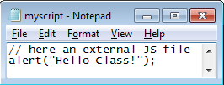
Including JavaScript in HTML
External JS File Example
Don’t Forget File Path if HTML & JS Files in Different Folders
CMPP 257: Introduction to JavaScript & JQuery

Slide 21


Basic JavaScript Instructions
Statement or Command
Enhancing Script Readability
Each Individual Step in a Script
Terminated with ;
Explaining What Code will Do.
var x;
document.write(‘Hello Class’);
Ignored by the Browser
// Anything after the two
// forward slashes is also a comment
// and will not be processed.
Single-Line Comments: // ……
/* Anything between these characters is a comment and will not be processed. */
Multi-Line Comments: /* ……*/
CMPP 257: Introduction to JavaScript & JQuery

Slide 22

Basic JavaScript Instructions
Writing a Text to HTML Document
Writing HTML Elements to HTML Doc.
document.write(“Welcome in JS”);
document.writeln("<h1>Hello World!</h1><p>Have a nice day!</p>");
write & writeln : Same Function
writeln() adds a new line character (You must use <pre> right before <script>
CMPP 257: Introduction to JavaScript & JQuery

Slide 23
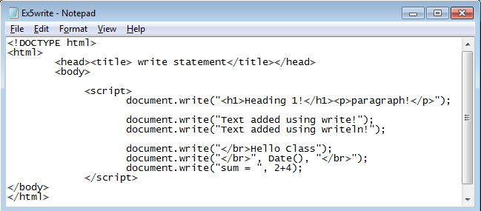

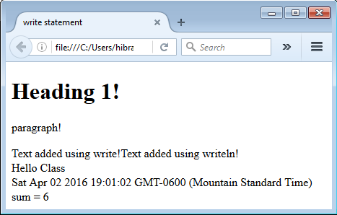
Basic JavaScript Instructions
Try: Include the Script within HEAD
CMPP 257: Introduction to JavaScript & JQuery

Slide 24
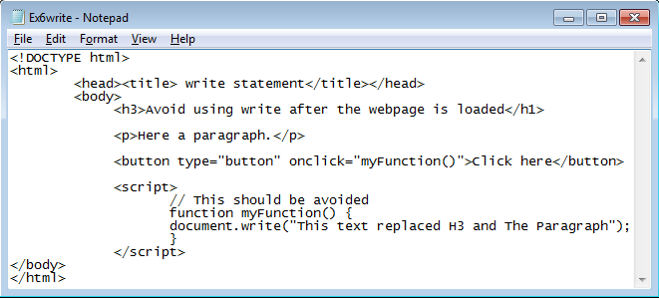

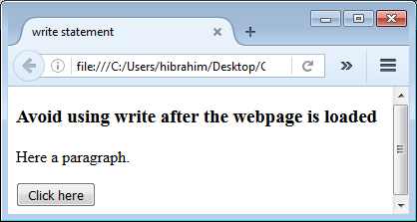
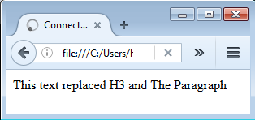
Basic JavaScript Instructions
Avoid It
Once Clicked
CMPP 257: Introduction to JavaScript & JQuery

Slide 25

Basic JavaScript Instructions
Display an Alert Box (Popup)
alert(message)
window.alert(“Welcome in JS”);
alert(‘Welcome in JS’);
Argument: variable, string, literal Values
alert(welcomeVar); | alert(5+6);
CMPP 257: Introduction to JavaScript & JQuery

Slide 26

Basic JavaScript Instructions
Display a Confirmation Box
Dialog Box: Message, OK, and Cancel
Verify that a User Accepts (Ok Button)
Verify that a User Rejects (Cancel Button)
Window.confirm(“Click OK or Cancel”);
It Returns:
True if OK is Clicked
False if Cancel is Clicked
CMPP 257: Introduction to JavaScript & JQuery

Slide 27
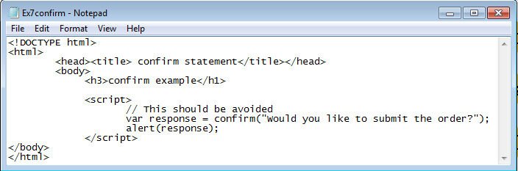

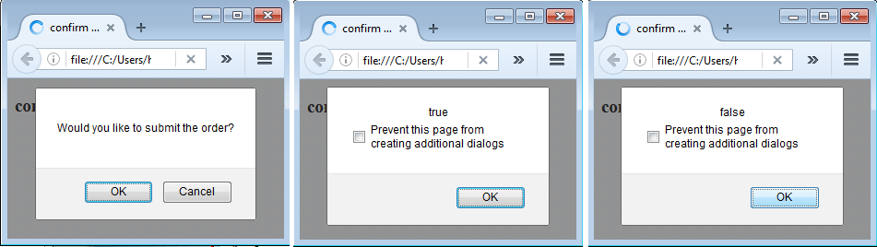
Basic JavaScript Instructions
OK is Clicked
Cancel is Clicked
CMPP 257: Introduction to JavaScript & JQuery

Slide 28

Basic JavaScript Instructions
Display a Prompt Box
Dialog Box Asking Users for Input
Click Ok → Returning The Input Value
Click Cancel → Returning NULL
Window.confirm(“Click OK or Cancel”);
CMPP 257: Introduction to JavaScript & JQuery

Slide 29
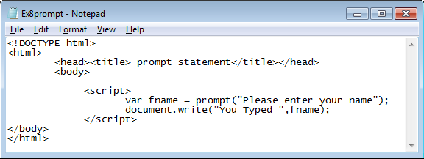

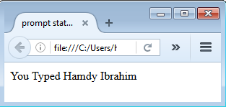
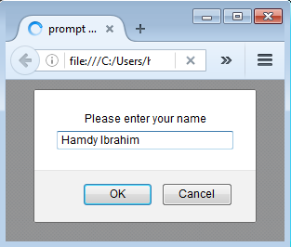
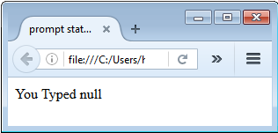
Basic JavaScript Instructions
Cancel is Clicked
CMPP 257: Introduction to JavaScript & JQuery

Slide 30
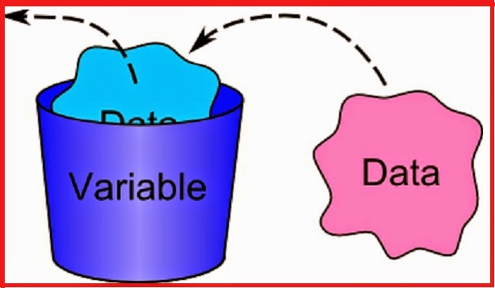
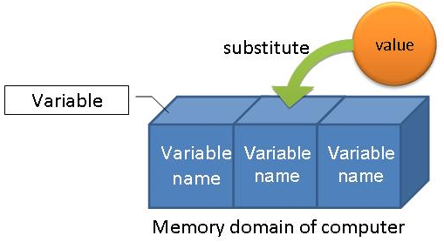
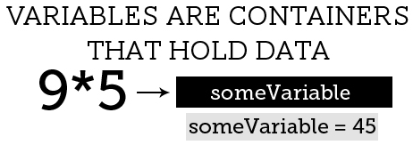
Variables
Scripts are developed to achieve a task.
It may require to store bits of information temporarily
These bits of information - or data - are stored in variables.
CMPP 257: Introduction to JavaScript & JQuery

Slide 31
Variables
Variable
Memory Location used to store Data
Implicit (Not Advised) or Explicit Declaration
Explicit Declaration using var
var firstValue; var firstValue = 5;
Has a Name, Type, Value, and Scope
CMPP 257: Introduction to JavaScript & JQuery

Slide 32
Variables Usage Steps
Variable Declaration
var quantity;
Keyword
Variable Name/identifier
2. Variable Access/Assignment
Variable_Name = Literal_Value
Quantity = 3;
Assignment Operator
// Read and Write
totalQuantity = Quantity * 2 ;
CMPP 257: Introduction to JavaScript & JQuery

Slide 33

Naming Variables
Variable Names
Called Identifiers
Short Names or More Descriptive Names
Can Have Letters, Digits, Underscore, $
Must Begin with a Letter, $, _
Case Sensitive (y does not equal Y)
Reserved Words Cannot Be Used
CMPP 257: Introduction to JavaScript & JQuery

Slide 34
Variables
Data Type | Description | Example
Number | Numeric (Integer or Real) Values | var x = 0.75; var y = -10;
String | Sequence of Characters (Use Single/Double Quotes) | var s1 = ‘Hi Class’, course_name = “JS”;
Boolean | Logical Values (True/False) | var b1 = true, b2 = false;
Array | For Storing Multiple Values in a Single Variable | var course = [“CMPN215", “CMPP257"];
Null | No value - Empty | var x = “”;
Undefined | Variable was declared but no value assigned. | var x; Alert(x);
Object | Non primitive variable containing data & instructions | Details later.
European Computer Manufacturer’s Association (ECMA): Standard definition
CMPP 257: Introduction to JavaScript & JQuery

Slide 35




















Variables: Memory Concepts
var firstVar;
var secondVar = 5;
firstValue
???
secondVar
5
Undefined
Number
firstVar = 7.11;
secondVar = “Hello”;
firstVar
7.11
secondVar
Hello
Number
String
firstVar = true;
firstVar
true
Boolean
CMPP 257: Introduction to JavaScript & JQuery

Slide 36
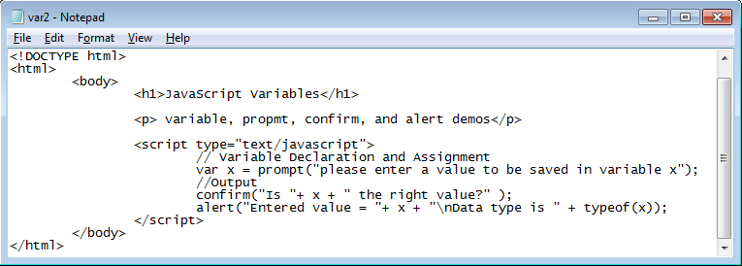
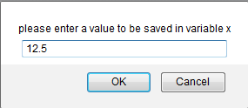
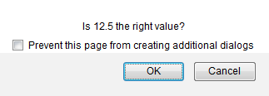
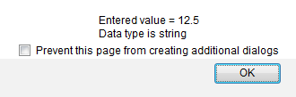
Variables
prompt()
confirm()
alert()
CMPP 257: Introduction to JavaScript & JQuery

Slide 37
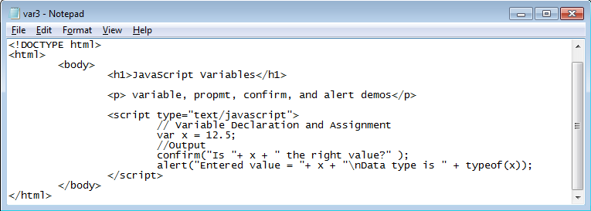

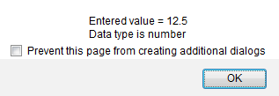
Variables
confirm()
alert()
Try: Change the above script to include multiple variables and assign a value of a variable to another variable.
CMPP 257: Introduction to JavaScript & JQuery

Slide 38

Mathematical Expression
Expression
Set of variables, Values, and Operators
Getting Some Calculations Done
var total = 0.9 * retail + gstTax;
Operators
Arithmetic, Comparison, and Logical Operators
Example
var width = 3;
var height = 2;
area = width * height;
Area = 3 * 2 = 6
CMPP 257: Introduction to JavaScript & JQuery

Slide 39

Mathematical Expression
Arithmetic Operators
Operator | Description | Example | Result (y = 3)
+ | Addition | X = y + 2 | X = 5
- | Subtraction | X = y – 2 | X = 1
* | Multiplication | X = y * 2 | X = 6
/ | Division | X = y /2 | X = 1.5
% | Modulus (Remainder) | X = y % 2 | X = 1
++ | Increment (Pre & Post) | ++y or y++ | y = 4
-- | Decrement (Pre & Post) | --y or y-- | y = 2
- | Negation (Negative) | -y | y = -3
Math.pow() | Exponentiation/Power | X = Math.pow(y,2) → X = 9
CMPP 257: Introduction to JavaScript & JQuery

Slide 40

Mathematical Expression
Operator Precedence
Operator | Priority
() | 1 – Highest
++, -- | 2
*, /, % | 3
+, - | 4 - Lowest
Order of Performing Operations in Expression
Expression: 4 / 2 + 8 * 4 – (5+2) % 3
1 | 4 / 2 + 8 * 4 – (5+2) % 3
2 | 4 / 2 + 8 * 4 – 7 % 3
3 | 2 + 8 * 4 – 7 % 3
4 | 2 + 32 – 7 % 3
5 | 2 + 32 – 1
6 | 34 – 1 → 33
Expression: 5 + 6 – 11 + 8 * 5 + 4
1 | 5 + 6 – 11 + 8 * 5 + 4
2 | 5 + 6 – 11 + 40 + 4
3 | 11 – 11 + 40 + 4
4 | 0 + 40 + 4
5 | 40 + 4 = 44
CMPP 257: Introduction to JavaScript & JQuery

Slide 41

Mathematical Expression
Concatenation Operator (+)
Joining/Combining Strings
var greeting = ‘Hello‘;
var name = ‘Class’;
var message = greeting + name;
Message = HelloClass
CMPP 257: Introduction to JavaScript & JQuery

Slide 42



Mathematical Expression
Operator | Example | Equivalent To
= | X = Y; | X = Y
+= | X += Y; | X = X + Y
-= | X -= Y; | X = X – Y
*= | X *= Y; | X = X * Y
/= | X /= Y; | X = X / Y
%= | X %= Y; | X = X % Y
Assignment
Assign a value to a variable or Do Math and Assign the Result
// prompt returns string
var rate = parseInt(prompt("What is the employee's pay rate? "));`
String
parseInt()
Integer
String
parseFloat()
Float
CMPP 257: Introduction to JavaScript & JQuery

Slide 43
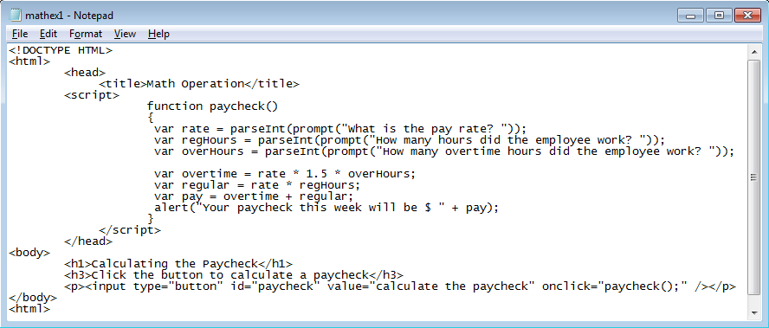

Mathematical Expression
Without Typing: What is the expected output?
CMPP 257: Introduction to JavaScript & JQuery

Slide 44

Comparison Operators
Comparison Operators
Operator | Description | Example | Result
== | Is equal to (value only) | X == 8 | False
 |  | X == 10 | True
=== | Both value and type are equal | X === 10 | True
 |  | X === “10” | False
!= | Is not equal | X != 5 | True
!== | Both value & type are not equal | X !== “10” | True
 |  | X !== 10 | False
> | Is greater than | X > 5 | True
>= | Is greater than or equal to | X >= 10 | False
< | Is less than | X < 5 | False
<= | Is less than or equal to | X <= 10 | True
CMPP 257: Introduction to JavaScript & JQuery

Slide 45
Comparison Operators
Logical Operators
Operator | Description | Example
&& | AND (both conditions must be True. | X <= 8 && Y >1
|| | OR (at least one condition must be true) | X == 6 || Y == 4
! | NOT (True → False or False → True) | !(X == Y)
Given: X = 6 and Y = 3 → What are the results?
CMPP 257: Introduction to JavaScript & JQuery

Slide 46




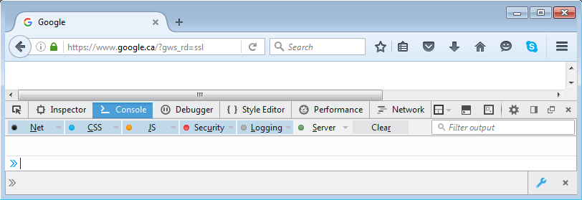
Browsers: JavaScript Development Toolbar
Internet Explorer
Firefox
F12
Google Chrome
CMPP 257: Introduction to JavaScript & JQuery

Slide 47



Tasks
Task 1: Write a script to concatenate different data types (e.g., string with numeric)
Task 1
Develop a webpage that includes a script for calculating:
  Average of Three Grades
  Calculating Total Sale of a Product after 20% discount with 5% GST.
Task 2
Thank You
Questions?
CMPN 215: Introduction to WEB Development

